Slide 1
Interpreting Test Results & Reports
Module 4

Slide 2
Interpreting Test Results and Reports
Module 1. Implementation Basics
Module 2. CASAS eTests Implementation
Module 3. Paper Test Implementation
Module 4. Interpreting Test Results and Reports
:
User Role* | Module 1 | Module 2 | Module 3 | Module 4
Tester – Administer eTests only | x | x |  | Optional
Tester – Administer Paper only | x |  | x | Optional
Tester – Administer eTests & Paper | x | x | x | Optional
Teachers | x |  |  | x
*Testers must complete at least two modules, including Module 1.

Slide 3
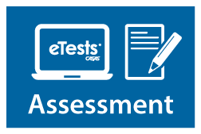
Integrated System Approach
Basic Skills Content Standards and CASAS Competencies
Reading, Listening, Math Assessments Paper or computer-based testing (eTests)
QuickSearch Online – free resource to find instructional material titles
TOPSpro Enterprise (TE) – data accountability software to score and track student test scores and generate reports
Notes:
CASAS is an integrated system. This module covers how to interpret test results and reports to guide instruction. The other 3 modules cover other aspects of the CASAS system.

Slide 4
Module 4: Interpreting Test Results & Reports Agenda
Purpose:
To provide information and strategies to understand and interpret test results from CASAS assessments.
Agenda
The foundation of the CASAS system:
College and Career Readiness Standards (CCR)
CASAS Content Standards
CASAS Competencies
Task Areas
Interpretation of reports with test results
Quick Search Online
Notes:
Testing for Accountability is not the primary reason or a good reason for testing.
Because of the time it takes to test, it is important for teachers and students to both benefit from testing.
The test results have value for both the learner and teacher.

Slide 5
CASAS test items measure basic language and math skills in realistic, everyday life and workplace contexts.
Task Areas
Content Standards
Competencies
Test items address:
content standards
competencies
task areas

Slide 6
In line 2, which word means the same as the underlined word liberal in this announcement?
generous
radical
traditional
widespread
Notes:
Test item example.

Slide 7
Content Standards
Academic skills in language and mathematics

Slide 8
College and Career Readiness (CCR) Standards*
Key Goals:
Ensure core college and career readiness requirements for adult learners are represented but also keep the overall content demands manageable
Include standards that are:
relevant to preparing adult students for success in higher education and training programs
most important for adult learners
*College and Career Readiness (CCR) Standards for Adult Education –
published by the U.S. Department of Education, Office of Career, Technical, and Adult Education (OCTAE) - April 2013.

Slide 9
Example of CCR Reading Standard
CCR Anchor 4: Interpret words and phrases as they are used in a text, including determining technical, connotative, and figurative meanings, and analyze how specific word choices shape meaning or tone.
A | B | C | D | E
Ask and answer questions to help determine or clarify the meaning of words and phrases in a text. | Determine the meaning of general academic and domain specific words and phrases in a text relevant to a topic or subject area. | Determine the meaning of general academic and domain specific words and phrases in a text relevant to a topic or subject area. Determine the meaning of words and phrases as they are used in a text, including figurative language such as metaphors and similes. | Determine the meaning of words and phrases as they are used in a text, including figurative, connotative, and technical meanings; analyze the impact of specific word choice on meaning and tone. | Determine the meaning of words and phrases as they are used in a text, including figurative, connotative, and technical meanings; analyze cumulative impact of specific word choices on meaning and tone.
Notes:
Each of these standards is then broken down into 5 level descriptors addressing the application of the standard at each level. Here you have CCR Reading Anchor 4 and level descriptors for 5 CCR levels, A to E. Level E has been truncated because of length.

Slide 10
In line 2, which word means the same as the underlined word liberal in this announcement?
generous
radical
traditional
widespread
CCR Standard
R4.B, C: Interpret words and phrases in a text
Notes:
Refer back to slide 9 for specific descriptions of R4. CCR levels B and C

Slide 11
CASAS Reading Standards Categories
RDG 1 - Foundational Literacy
RDG 2 - Language and Vocabulary
RDG 3 - Reading Comprehension Skills and Strategies
RDG 4 - Higher Order Reading Skills and Strategies
RDG 5 - Higher Order Reading Skills and Strategies – Literary Texts Only

Slide 12
CASAS Reading Standards example
RDG 2 Language and Vocabulary
ABE/ASE NRS Level |  |  |  | 1 | 2 | 3 | 4 | 5 | 6
ESL NRS Level |  | 1 | 2 | 3 | 4 | 5 | 6
CS # | Content Standard CASAS Instructional Level | A | A | A | B | B | C | D | E
RDG 2 | Language and Vocabulary
RDG 2.1 | Interpret the conventions of standard English including punctuation (e.g., periods, appropriate placement of commas, quotation marks) and capitalization (e.g., at the beginning of a sentence, proper nouns). [L2. A, B, C, D, E] |  |  |  |  |  |  |  | 
RDG 2.2 | Read and interpret high-frequency words, phrases, and abbreviations in everyday contexts (e.g., signs, ads, labels, forms). [L6. A, B] [R4. A] |  |  |  | 
RDG 2.3 | Interpret accurately a range of general academic (e.g., indicate, procedure, evidence), technical (e.g., phlebotomist), and domain-specific words and phrases (e.g., endangered species, peace treaty) in context, including collocations (e.g., count on, happen to). [L6. B, C, D, E] [R4. B, C, D, E] |  |  |  |  |  |  |  | 
Notes:
Example of how CASAS Reading Standards Categories are further defined within the category, NRS level, and CASAS Instructional Level.
CCR standards aligned to each CASAS Standard are noted in brackets. For example RDG 2.2 is aligned to CCR standards L6. at CCR levels A, B and R4. at CCR level A

Slide 13
In line 2, which word means the same as the underlined word liberal in this announcement?
generous
radical
traditional
widespread
CASAS Reading Standard
RDG 2.8 - Interpret multiple-meaning words
Notes:
Test item example.

Slide 14
CASAS Reading Standards – CCR Alignment
ABE/ASE NRS Level |  |  |  | 1 | 2 | 3 | 4 | 5 | 6
ESL NRS Level |  | 1 | 2 | 3 | 4 | 5 | 6
CS # | Content Standard CASAS Instructional Level | A | A | A | B | B | C | D | E
RDG 2.7 | Interpret nuances, connotative meaning of words, and figurative language (e.g., analogies, idioms, similes and metaphors) as used in the text. [L5. A, B, C] [R4. C, D, E] |  |  |  |  |  |  |  | 
RDG 2.8 | Interpret unknown and multiple-meaning words as used in the text, choosing from level-appropriate strategies (e.g., context clues). [L4. A, B, C, D, E] [R4. A, B, C, D, E] |  |  |  |  |  |  |  | 
CCR Anchor R4: Interpret words and phrases as they are used in a text, including determining technical, connotative, and figurative meanings, and analyze how specific word choices shape meaning or tone.
Notes:
CCR standards aligned to each CASAS Standard are noted in brackets.
For example RDG 2.8 is aligned to CCR standards L4. at CCR Levels A, B, C, D, E and R4. at CCR Levels A, B, C, D, E

Slide 15
Competency
The functional life skills context in which the learning objective is being measured

Slide 16
CASAS Competency Categories
0. Basic Communication
Consumer Economics
Community Resources
Health
Employment
Government and Law
Math
Learning and Thinking Skills
Independent Living

Slide 17
CASAS Competencies – example
4. Employment
4.6 Communicate effectively in the workplace
4.6.1 Follow, clarify, give, or provide feedback to instructions; give and respond appropriately to criticism
4.6.2 Interpret and write work-related correspondence, including notes, memos, letters, and e-mail
4.6.3 Interpret written workplace announcements and notices (see also 4.4.3)
4.6.4 Report progress on activities, status of assigned tasks, and problems and other situations affecting job completion
4.6.5 Select and analyze work-related information for a given purpose and communicate it to others orally or in writing

Slide 18
In line 2, which word means the same as the underlined word liberal in this announcement?
generous
radical
traditional
widespread
CASAS Competency
4.2.4 Interpret employee handbooks, personnel policies, and job manuals.
Notes:
Test item example.

Slide 19
Task Area
Format of the test item prompt

Slide 20
Reading Task Area Categories
1 - Forms
2 - Charts, tables, graphs, etc.
3 - Text
4 - Signs, ads, labels, etc.
5 - Measurement scales and diagrams

Slide 21
In line 2, which word means the same as the underlined word liberal in this announcement?
generous
radical
traditional
widespread
Reading Task Area
3 - Text
Notes:
Test item example.

Slide 22
In line 2, which word means the same as the underlined word liberal in this announcement?
generous
radical
traditional
widespread
CCR Standard: R4.B, C - Interpret words and phrases in a text
CASAS Content Standard: RDG 2.8 - Interpret multiple-meaning words
CASAS Competency: 4.2.4 - Interpret employee handbooks, personnel policies, and job manuals.
Reading Task Area: 3 - Text
Notes:
Test item example.

Slide 23
In Summary…
Content Standards, Competencies, and Task Areas create the foundation of the CASAS System.
Separately, they provide:
basic skills for successful attainment of learning objectives
life and work skills contexts
a variety of visual prompts

Slide 24
Activity 1 – Practice with Content Standards, Competencies, and Task Areas
Look at Activity 1 in your Activity Packet.
For the sample item on page 1, use the information on pages 2 - 7 in the Activity Packet and on slide 20 in the Power Point to determine:
CCR Standard
CASAS Content Standard
CASAS Competency Standard
Task Area
Notes:
Answers to Activity 1 – pages 2 – 7 in the Activity Packet:
CCR Standard R1. C
CASAS Content Standard RDG 4.4
CASAS Competency Standard 4.1.2
Task Area (1) Forms

Slide 25
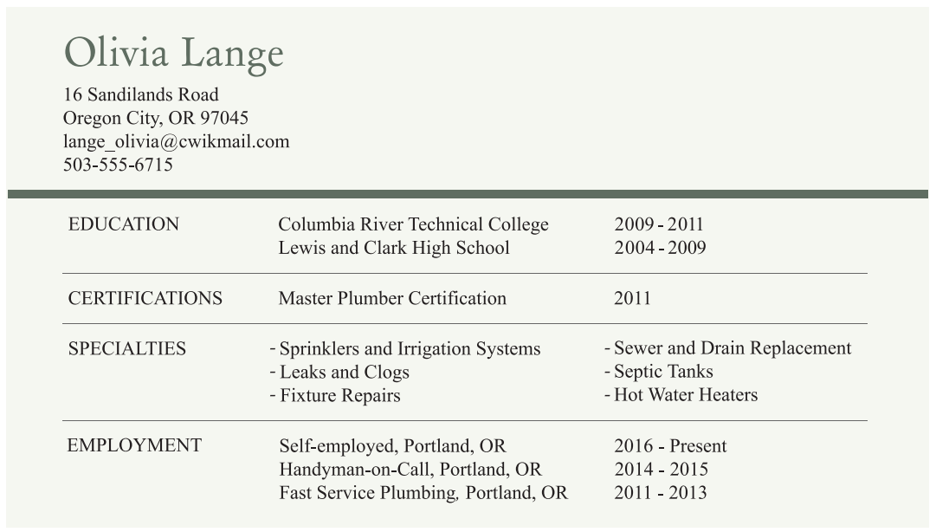
Based on Olivia’s resumé, she would most likely be hired to repair a _____.
broken lawnmower
broken windowpane
slow-draining sink
slow-running computer

Slide 26
Assessments: Levels & Forms
CASAS assessments cover from Beginning Literacy to transition to post-secondary: Level A (beginning), B, C, to Level D (advanced)
Forms are color-coded by CASAS in all series.
Two alternate forms at each level (e.g., Level B is 903 & 904; 904 is NOT a higher level test than 903. Both tests have the same level of difficulty.
5 points on the CASAS scale is an average gain for students that attend for 70 – 100 hours. .
Notes:
Note Colors for levels
A level – Blue
B Level – Green
C Level – Brown
D Level - Red

Slide 27
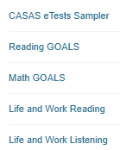
Sample Test Items Activity
Review and compare sample test items. Sample eTests and paper test formats are available at www.casas.org:
Use sample test items to:
familiarize and give students practice with CASAS items
make future testing go more smoothly
help reduce student test-taking anxiety
Notes:
ACTIVITY –
Option 1 Print and pass out 1 set of Sample Test Items (Levels A, B, C and D) to small groups. (You may choose which test series to include.)
https://www.casas.org/product-overviews/curriculum-management-instruction/sample-test-items/reading-goals
Option 2 – If the training room has internet connection, you can demonstrate any of the sample test items by going to:
https://www.casas.org/product-overviews/curriculum-management-instruction/sample-test-items/reading-goals or
https://casasportal.org/eTests
Option 3 – If the training room has internet connection and participants have laptops, they can find and review sample items.
Ask participants to browse through the forms.
ANSWER: Going from A to D, the items get more difficult; questions use more advanced language; reading passages are longer

Slide 28
Instructional Reports

Slide 29
Types of Instructional Reports
Score Reports and Test History
Personal Score Report
Student Test Summary Report
Learning Gains Report
Skill Reports
Content Standard Performance
Competency Performance
Individual Skills Profile
Notes:
Reports from TE Online are available for instructors to generate for individual students and for their class.
The Data Manager/Test Admin can give teachers Access Rights to see their own class information.
This module focuses on reports that instructors most commonly use.
Score Reports are generated from TE.
Skill Reports can be generated from TE or generated manually using templates in the Test Administration Manuals.

Slide 30
Score Reports
Personal Score Report
gives a summary of the student’s results on a given test form
Notes:
This is a report in eTests, but also can be generated in TE to show the student.

Slide 31
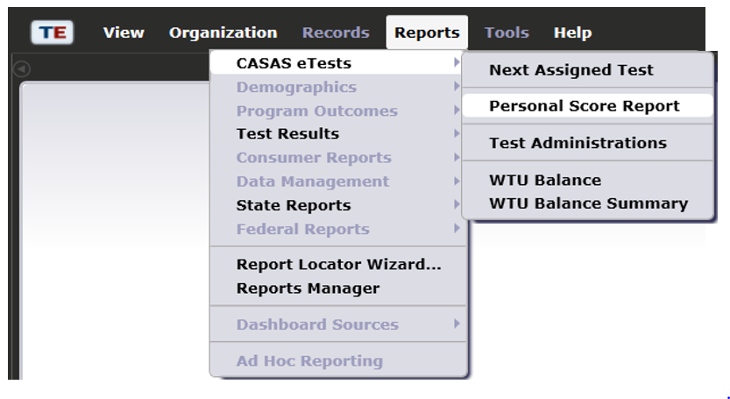
Personal Score Report
Notes:
The CASAS eTests “Reports” category gives you access to reports from web-based testing.
Personal Score Report
This report appears at the end of every eTests test administration. It can also be accessed from TOPSpro Enterprise (TE).

Slide 32
Personal Score Report
Page 1 of 1
PSR
01/01/2019
15:36:29
Jennifer Lee
Agency:
Site:
4908 – Rolling Hills Adult School (RHAS) 11 – RHAS: North City
Class: Teacher:
220 - ABE
N/A
Modality | Test Form | Test Level | Test Date | Scale Score | NRS Level
Reading | 905R | C | 05/05/2019 | 220 | ABE Level 3
263
6
248
5
238
ABE Level 3
4
227
NRS Level
3
220
Understands common vocabulary on familiar subjects. Locates specific information in short familiar text and in ordered lists.
Interprets a variety of simple forms in common life and work contexts.
Understands simple written instructions. Understands basic terms in common computer applications.
216
2
203
1
165

Slide 33
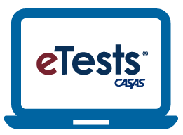
Raw Scores and Scale Scores
Raw Score: the number of questions a student answers correctly
Scale Score: converts a student's raw score on a test to a common scale that allows for comparison between students.
Each test form has its own Raw to Scale Score chart.
For example, a raw score of 12 is a scale score of 213
https://casasportal.org/eTests
Notes:
Converting the Raw Score to scale scores
Remember, the raw score is the number correct on the test. But this is not the score you will use. You will use a “scale score”.
Convert the raw score to a scale score using a chart like this one.
NOTE – eTests automatically scores each test and calculates the raw and scale score.

Slide 34
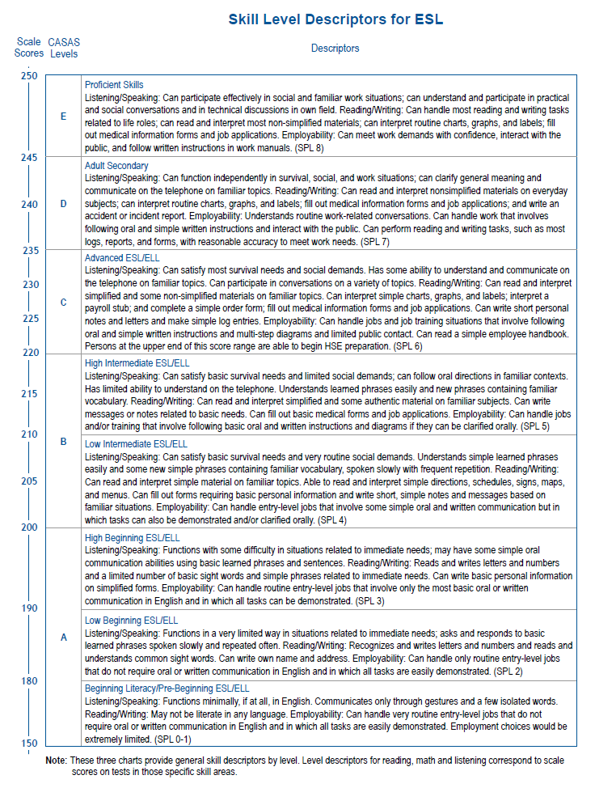
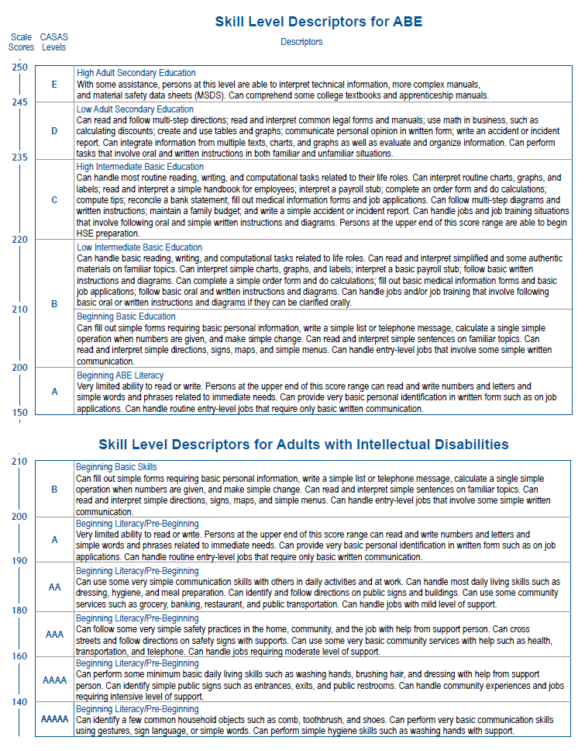
Skill Level Descriptors
The Skill Level Descriptors provide general information on how to interpret a learner’s scale score with respect to the common job-related and life skill tasks.
Notes:
See Activity Packet - pages 8 and 9 for full size
Skill Level Descriptors
These are available online at www.casas.org.
Each test modality (e.g., reading, listening) measures the ability of a student for the skill tested. You should not assume student’s writing and speaking skills are the same as their reading skills.
CASAS scores from more than one modality should not be averaged.
Testing reading skills? Only the reading descriptors apply.

Slide 35
Score Reports
Student Test Summary Report
lists all tests, scores and test hours of instruction
Notes:
This report can be generated for students tested or for a given class.

Slide 36
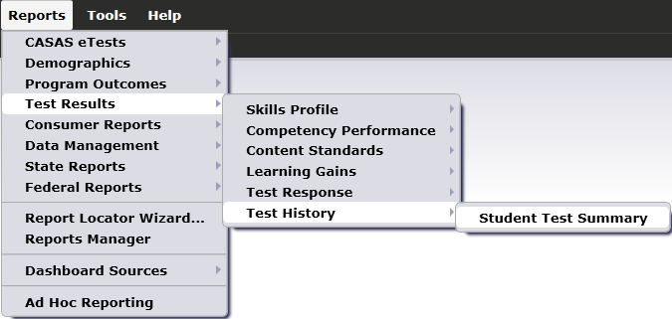
Student Test Summary Report
Notes:
Test History
Student Test Summary

Slide 37
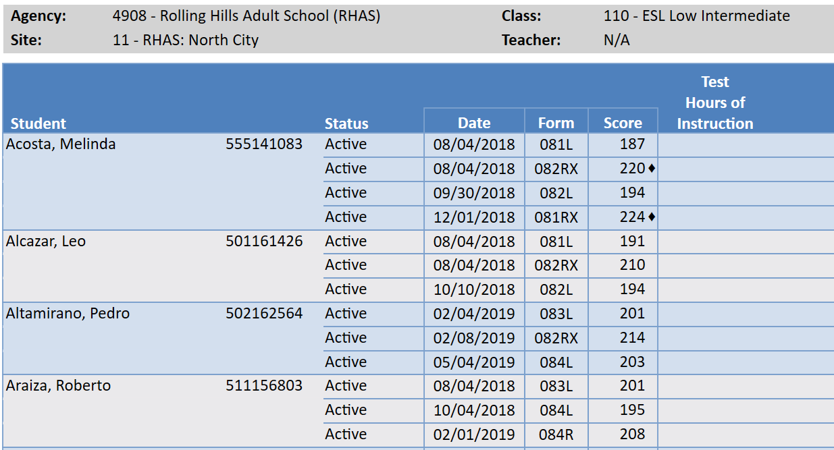
Student Test Summary
Notes:
• Tracks test administrations, or limit display to show only tests administered to one class.
• Identifies all tests related to a student.
• Identifies students who have not tested, or who have taken a pretest but not a post-test.
• Identifies inaccurate and conservative estimate test scores.
Access TE: Reports > Test Results > Test History > Student Test Summary
In General Settings > Special Options, set Display Class Based On > Class Enrollment.
Use the Navigator to select a Class Instance and generate the STS.
The Student Test Summary by Class report lists every student that has taken a test in the selected class and displays test history for each student.
Tests are listed in test date order for each student.
The report displays test date, the specific test given (Form number), scale score, and cumulative hours of instruction.
The report also identifies test scores below the accurate range with an asterisk (*) and high-end conservative estimate scores with a diamond symbol ().
How to use:
Identify all tests each student has taken in a class.
Identify test scores that are invalid (asterisk) in a class.
Identify students who have taken a specific test (Form Number) in a class.
Sort tests by form number to see what students have taken each test.

Slide 38
Score Reports
Learning Gains Report
provides a list of student test scores by class and displays learner gains from pretest to post-test

Slide 39
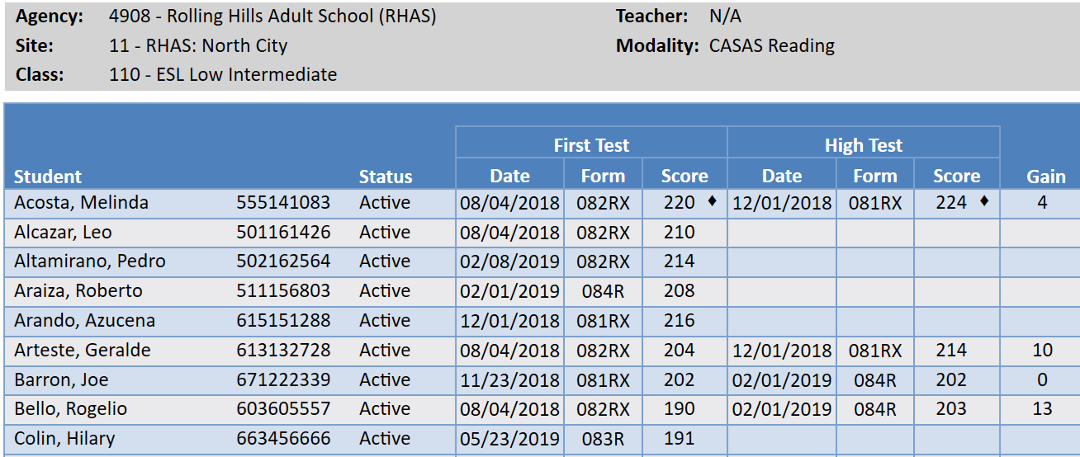
Learning Gains Report
Notes:
Teachers can note progress by class and by student.
Access TE: Reports > Test Results > Learning Gains> Student Learning Gains
.
There are several options for this report:
First to Last
Last to First
First to High
First to Second
Highest to First
Last Two Tests

Slide 40
NRS EFLs/CASAS Reading Score Ranges for ABE/ASE
Educational Functioning Levels |  | CASAS Level | Reading GOALS Scale Score Ranges
1 | Beginning ABE Literacy | A | 203 & below
2 | Beginning Basic Education | B | 204-216
3 | Low Intermediate Basic Education | B | 217-227
4 | High Intermediate Basic Education | C | 228-238
5 | Low Adult Secondary Education | D | 239-248
6 | High Adult Secondary Education | E | 249 & above
Notes:
Relationship to NRS Educational Functioning Levels (EFLs) for ABE and ASE
Agency testing information can be reported to the federal government – US Dept. of Education, Office of Vocational, Adult, and Training Education (OCTAE) or to the US Department of Labor (DOL) via state offices. The US DOL is the agency that grants the WIOA Title I funding and OCTAE is the agency that grants the WIOA Title II funding to each state. States report how many students are placed at each level and how many students complete an EFL (Educational Functioning Level) in the National Reporting System (NRS). CASAS scale score ranges are aligned to the NRS EFLs.

Slide 41
Instructional Reports
Skill Reports
Content Standard Performance
Competency Performance
Individual Skills Profile

Slide 42
Targeting Instruction
Use reports to inform instruction, both at the student level and at the class level.
Reports can help determine which skills to target in your lessons:
College and Career Readiness Standards
CASAS Content Standards
CASAS Competencies
Task Areas

Slide 43
Skill Reports
Student Content Standard Performance
provides detailed information on student test results by
test item
CASAS content standard
Content Standard Performance Summary
a class-level report teachers use to target the areas of greatest need for the entire class.

Slide 44
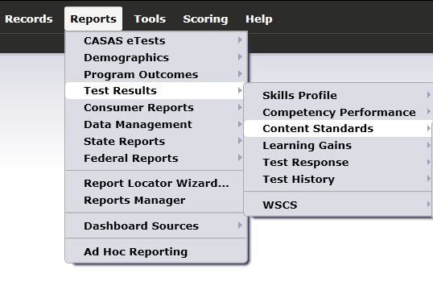
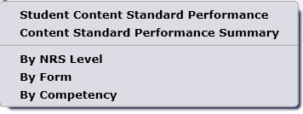
Content Standard Reports

Slide 45
Student Performance
by Test & Content Standard
01/06/2019
23:30:59
Page 1 of 1
SCSTC
Agency:
Site: Class: Course:
4908 – Rolling Hills Adult School (RHAS)
11 – RHAS: North City
61392 - Reading Skills 3
RS3BEE
Form:
Student: Perez, Maria
Test Date: 01/06/2019
Raw Score: 19 Scale Score: 220
906R - Reading GOALS Level C
ID: 123456
Teacher:
CASAS
Reading
Standards | No. of
(2016) | Items | Correct | Content Standard Description
RDG2.3 | 4 | 50 % | Interpret accurately a range of general academic (e.g., indicate, procedure, evidence), technical e.g., phlebotomist), and domain-specific words and phrases (e.g., endangered species, peace treaty) in context.
RDG2.8 | 3 | 0 % | Interpret unknown and multiple-meaning words as used in the text, choosing from level- appropriate strategies (e.g., sentence-level, paragraph or complete text context, known affix, root words).
RDG3.11 | 2 | 50 % | Identify the main idea of a simple text or the central ideas or themes of a complex text.
RDG3.12 | 13 | 38 % | Identify the key details and cite evidence from a text.
RDG3.14 | 3 | 100 % | Identify the author’s purpose including what the author wants to answer, explain or describe.
RDG4.3 | 2 | 100 % | Determine what a text says implicitly (e.g., make inferences, draw conclusions) and cite textual evidence.
RDG4.4 | 7 | 43 % | Analyze how and why individuals, events, and ideas develop and interact over the course of a text, including time, cause/ effect, sequence (e.g., following multi-step directions).
RDG4.6 | 1 | 0 % | Analyze how the author’s purpose, point of view, opinion, register, tone and voice, including political or cultural perspective, shape the content and style of a text for its intended audience. Distinguish own point of view, including personal experience, from the author’s point of view.
RDG4.7 | 2 | 50 % | Explain, delineate, analyze, and evaluate the truthfulness, validity, relevance, and sufficiency of arguments, specific claims and supporting evidence in expository, academic or non-fiction text, including differentiating fact from opinion (e.g., advertising claims, news articles, case studies).
RDG4.8 | 3 | 67 % | Integrate and analyze how two or more texts address similar or conflicting themes or topics in order to build knowledge, compare or contrast the approaches the author(s) takes, or identify where the texts agree or disagree on matters of fact or interpretation.
Notes:
Student Performance by Content Standard Report
• This report can be generated in a variety ways to help teachers and students determine where to focus instruction and learning.
• Students and teachers can determine skills that reflect strengths and those that need improvement.
• Teachers can focus on these skills in class before post-testing.
Presenter to orient participants to reports.
Who is the student on the report?
What test did she take?
Raw Score
Scale Score
How are results presented?
AVAILABLE IN BASIC & ENHANCED TE PACKAGE

Slide 46
Class -- Content Standard Performance Summary
Class Performance
by Test & Content Standard
01/06/2019
23:34:49
Page 13 of 32
SCSSTC4
Agency:
Site: Class:
Course:
4908 – Rolling Hills Adult School (RHAS)
11 – RHAS: North City
61392 - Reading Skills 3
RS3BEE
Teacher:
521457 - Goldberg, C
Form:
Total Tests:
906R - Reading GOALS Level C
13 Total Students: 13
CASAS
Reading
Standards | No. of
(2016) | Items | Correct | Content Standard Description
RDG2.3 | 4 | 56 % | Interpret accurately a range of general academic (e.g., indicate, procedure, evidence), technical e.g., phlebotomist), and domain-specific words and phrases (e.g., endangered species, peace treaty) in context, including collocations (e.g., count on, happen to).
RDG2.8 | 3 | 51 % | Interpret unknown and multiple-meaning words as used in the text, choosing from level- appropriate strategies (e.g., context clues).
RDG3.11 | 2 | 65 % | Identify the main idea of a simple text or the central ideas or themes of a complex text.
RDG3.12 | 13 | 57 % | Identify the key details and cite evidence from a text.
RDG3.14 | 3 | 59 % | Identify the author’s point or purpose including what the author wants to answer, explain or describe.
RDG4.3 | 2 | 58 % | Determine what texts says explicitly by comparing details from multiple sources or parts of a text.
RDG4.4 | 7 | 52 % | Determine what texts says implicitly (e.g., make inferences, draw conclusions) and cite textual evidence.
RDG4.6 | 1 | 23 % | Use text features (e.g., bold face print, symbols) to locate key details and interpret how these features influence meaning.
RDG4.7 | 2 | 65 % | Describe and analyze the overall structure and organization of a text (e.g., chronology, case and effect, comparison and contrast, problem and solution.
RDG4.8 | 3 | 67 % | Analyze how the author’s point of view, purpose, opinion, register, tone, and voice, including political or cultural perspective, shape the content and style of a text for its intended audience.
Notes:
Class Content Standard Performance Summary
Presenter to orient participants to reports.
How many students are in the class on the report?
What test did they take?
How are results presented?
• This report can be generated in a variety ways to help teachers and students determine where to focus instruction and learning.
How is this report sorted? (by CASAS Content Standard).
How else could this report be sorted? (by % correct)
• Students and teachers can determine skills that reflect strengths and those that need improvement.
• Teachers can focus on these skills in class before post-testing.
AVAILABLE ONLY IN ENHANCED TE PACKAGE

Slide 47
Activity 2 – Content Standard Performance
Look at the Content Standard Performance reports in your Activity Packet on pages 11 - 12. Discuss with someone next to you and write answers to these questions on page 10:
What can you learn about students from these reports?
How would you use the results to understand students and inform future instruction?
Do you think that there are ways that the results could be misused?
Notes:
Group activity where participants discuss with someone near them. Then whole group discussion.
Presenter to orient people to reports.
Who is the student on the report?
What test did she take?
Raw Score
Scale Score
How are results presented?
One way that reports can be misused is when too much weight is given to a wrong answer on one single item. For example, if there is only 1 item, should that change instruction based on the performance on that one item?
Test results are also just one measure of student performance. These results should be balanced with teacher observations.

Slide 48
Skill Reports
Competency Performance Summary
a class-level report teachers use to target the areas of greatest need for the entire class.
Student Competency Performance
provides detailed information on student test results by
test item
competency
task area

Slide 49
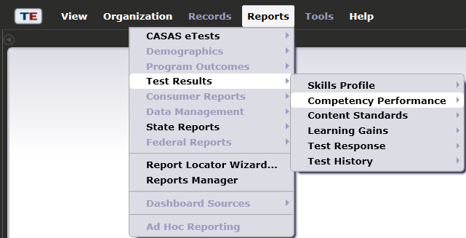
Student Competency Performance
Notes:
Competency Performance
Student Competency Performance
Competency Performance Summary by Class

Slide 50
Student Competency Performance
Agency:
Site:
Class:
Course:
4908 – Rolling Hills Adult School (RHAS)
11 – RHAS: North City
61392 - Reading Skills 3
RS3BEE
Form:
Student:
Test Date: 01/05/2019
Raw Score: 19 Scale Score: 220
906R - Reading GOALS Level C
Perez, Maria ID: 123456
Teacher:
521457 - Goldberg, C
Position | Correct? | Comp No. | Task | Competency Description
1 | No | 4.2.5 | 2 | Interpret information about employee benefits
2 | No | 4.2.5 | 2 | Interpret information about employee benefits
3 | Yes | 4.2.5 | 2 | Interpret information about employee benefits
4 | No | 4.2.5 | 2 | Interpret information about employee benefits
5 | Yes | 4.4.3 | 1 | Interpret job-related signs, charts, diagrams, forms, etc.
6 | No | 4.4.3 | 1 | Interpret job-related signs, charts, diagrams, forms, etc.
7 | Yes | 4.4.3 | 1 | Interpret job-related signs, charts, diagrams, forms, etc.
8 | Yes | 4.4.3 | 1 | Interpret job-related signs, charts, diagrams, forms, etc.
9 | Yes | 4.6.2 | 2 | Interpret work-related correspondence, e.g. memos and e-mail
10 | Yes | 4.6.2 | 2 | Interpret work-related correspondence, e.g. memos and e-mail
11 | Yes | 4.6.2 | 2 | Interpret work-related correspondence, e.g. memos and e-mail
12 | Yes | 4.6.2 | 2 | Interpret work-related correspondence, e.g. memos and e-mail
13 | No | 4.6.2 | 2 | Interpret work-related correspondence, e.g. memos and e-mail
14 | Yes | 1.7.3 | 3 | Interpret product instructions, directions, labels
15 | No | 1.7.3 | 3 | Interpret product instructions, directions, labels
Notes:
See page 14 in the Activity Packet for full size
Student Competency Performance
• This report can be generated in a variety ways to help teachers and students determine where to focus instruction and learning.
• Students and teachers can determine skills and competencies that reflect strengths and those that need improvement.
• Teachers can focus on these skills in class before post-testing.
Presenter to orient people to reports.
Who is the student on the report?
What test did she take?
Raw Score
Scale Score
How are results presented?
See page 5 in Activity Packet
AVAILABLE IN BASIC & ENHANCED TE PACKAGE

Slide 51
Class -- Competency Performance Summary
Class Performance
by Test Item & Competency
01/6/2019
23:09:16
Page 1 of 5
SCPSTIC4
Agency:
Site:
Class:
Course:
4908 – Rolling Hills Adult School (RHAS)
11 – RHAS: North City
61392 - Reading Skills 3
RS3BEE
Teacher:
521457 - Goldberg, C
Form:
Total Tests:
906R - Reading GOALS Level C
13 Total Students: 13
Position | Correct? | Comp No. | Task | Competency Description
1 | 61 % | 4.2.5 | 2 | Interpret information about employee benefits
2 | 61 % | 4.2.5 | 2 | Interpret information about employee benefits
3 | 69 % | 4.2.5 | 2 | Interpret information about employee benefits
4 | 69 % | 4.2.5 | 2 | Interpret information about employee benefits
5 | 69 % | 4.4.3 | 1 | Interpret job-related signs, charts, diagrams, forms, etc.
6 | 92 % | 4.4.3 | 1 | Interpret job-related signs, charts, diagrams, forms, etc.
7 | 46 % | 4.4.3 | 1 | Interpret job-related signs, charts, diagrams, forms, etc.
8 | 53 % | 4.4.3 | 1 | Interpret job-related signs, charts, diagrams, forms, etc.
9 | 46 % | 4.6.2 | 2 | Interpret work-related correspondence, e.g. memos and e-mail
10 | 61 % | 4.6.2 | 2 | Interpret work-related correspondence, e.g. memos and e-mail
11 | 61 % | 4.6.2 | 2 | Interpret work-related correspondence, e.g. memos and e-mail
12 | 69 % | 4.6.2 | 2 | Interpret work-related correspondence, e.g. memos and e-mail
13 | 61 % | 4.6.2 | 2 | Interpret work-related correspondence, e.g. memos and e-mail
14 | 38 % | 1.7.3 | 3 | Interpret product instructions, directions, labels
15 | 76 % | 1.7.3 | 3 | Interpret product instructions, directions, labels
16 | 46 % | 1.7.3 | 3 | Interpret product instructions, directions, labels
17 | 61 % | 1.7.3 | 3 | Interpret product instructions, directions, labels
18 | 46 % | 4.4.1 | 2 | Identify behavior, attitudes for job retention, advancement
19 | 76 % | 4.4.1 | 2 | Identify behavior, attitudes for job retention, advancement
20 | 53 % | 4.4.1 | 2 | Identify behavior, attitudes for job retention, advancement
Notes:
See page 15 in the Activity Packet for full size
AVAILABLE ONLY IN ENHANCED TE PACKAGE

Slide 52
Student Performance by Competency Category
Student Performance
by Competency Category
01/06/2019
20:22:49
Page 1 of 1
SCPCC
Agency:
Site: Class: Course:
4908 – Rolling Hills Adult School (RHAS)
11 – RHAS: North City
61392 - Reading Skills 3
RS3BEE
Teacher:
521457 - Goldberg, C
Form Level:
Student:
Total Tests:
C
Perez, Maria ID: 123456
1
Comp No. Correct | Competency Description | No. of Items
1.7 25 % | Understand procedures for care of personal possessions | 4
4.2 25 % | Understand wages, benefits, and employee organization | 4
5.4 33 % | Understand information about taxes | 6
4.4 46 % | Understand concepts and materials related to job performance | 13
3.6 50 % | Understand basic health and medical information | 4
5.6 75 % | Understand civic responsibilities and activities | 4
4.6 80 % | Communicate effectively in the workplace | 5
Notes:
See page 16 in the Activity Packet for full size
Student Performance by Competency Report
• This report differs from the previous competency report in that it presents results in larger categories that are broader and perhaps easier to target instruction to.
Presenter to orient people to reports.
Who is the student on the report?
What test did she take?
How are results presented?
See page 5 in Activity Packet
AVAILABLE IN BASIC & ENHANCED TE PACKAGE

Slide 53
Class Performance Summary by Competency Category
Student Performance Summary
by Competency Category
Page 1 of 1
SCPCC
01/06/2019
20:22:49
Agency:
Site:
Class: Course:
4908 – Rolling Hills Adult School (RHAS)
11 – RHAS: North City
61392 - Reading Skills 3
RS3BEE
Teacher:
521457 - Goldberg, C
Form:
Total Tests:
906R - Reading GOALS Level C
13 Total Students: 13
Comp No. Correct | Competency Description | No. of Items
5.4 50 % | Understand information about taxes | 78
4.4 52 % | Understand concepts and materials related to job performance | 169
1.7 55 % | Understand procedures for care of personal possessions | 52
5.6 55 % | Understand civic responsibilities and activities | 52
4.6 60 % | Communicate effectively in the workplace | 65
3.6 65 % | Understand basic health and medical information | 52
4.2 65 % | Understand wages, benefits, and employee organization | 52
Notes:
See page 17 in the Activity Packet for full size
AVAILABLE ONLY IN ENHANCED TE PACKAGE

Slide 54
Activity 3 - Competency Performance
Look at the Student Performance by Competency Report in your Activity Packet on pages 14 - 15. Discuss with someone next to you and write the answers on page 13:
What can you learn about students from these reports?
How would you use the results to understand students and inform future instruction?
Do you think that there are ways that the results could be misused?
How do these report compare to the Content Standard reports?
Notes:
Group activity where participants discuss with those around them. Then whole group discussion.
How is this report currently sorted ? (by Position – in item order on the test form)
How could this report be sorted to be more useful? (by Correct -- Yes/No; by Competency Number; by Task Area)

Slide 55
Skill Reports
Individual Skills Profile
student-level report that includes performance on competencies, task areas, and content standards by skill area
Individual Skills Profile Summary
class-level report that includes performance on competencies, task areas, and content standards by skill area

Slide 56
Individual Skills Profile Report
Notes:
The Test Results report category gives you access to performance reports for students and classes.
Skills Profile
Individual Skills Profile- student level
Individual Skills Profile Summary

Slide 57
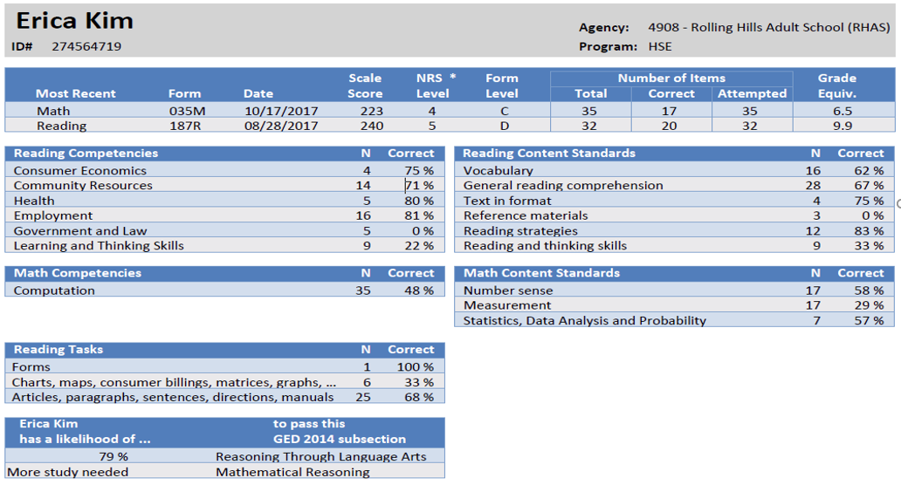
Individual Skills Profile
Notes:
Individual Skills Profile Report
For ASE students who score 236 and above on certain test forms, the report will display information about the student’s likelihood of passing each subsection of the GED.
Study of the CASAS Relationship to GED® 2014 posted at www.CASAS.org.
There are ongoing studies being conducted with HiSET and GED and the new CASAS GOALS reading and math series.
**An indicator of HiSet readiness will be provided soon for Reading GOALS.
Presenter to orient people to reports.
Who is the student on the report?
What test did she take?
Raw Score
Scale Score
How are results presented?
Where are Erica’s strengths?
Where does she need more practice/instruction?

Slide 58
Individual Skills Profile Summary
Individual Skills Profile Summary
by Site
05/22/2019
23:22:13
Page 4 of 4
ISPS3
Agency:
4908 – Rolling Hills Adult School (RHAS)
001 - RSCCD: Centennial Education Center (CEC) 11 11 – RHAS: North City
ABE
Form Level: C
Total Tests: 26
Site:
Program:
Total Students: 26
Mean Most Recent Students Date Range Score | Mean Number of Items
 | Total | Correct | Attempted
Reading 26 07/13/2018 - 12/04/2018 225 | 40 | 24 | 40
Reading Competencies | N | Correct
Consumer Economics | 134 | 62 %
Community Resources | 30 | 73 %
Health | 80 | 58 %
Employment | 566 | 60 %
Government and Law | 230 | 57 %
CASAS Reading Standards (2016) | N | Correct
Language and Vocabulary | 182 | 54 %
Reading Comprehension Skills | 462 | 61 %
Higher Order Reading Skills | 396 | 61 %
Reading Tasks | N | Correct
Forms | 178 | 57 %
Charts, maps, consumer billings, matrices, gra… | 598 | 59 %
Articles, paragraphs, sentences, directions, m… | 252 | 62 %
Signs, price tags, advertisements, product labe… | 12 | 75 %

Slide 59
Activity 4 – Interpreting the Individual Skills Profile Report
Look at the Individual Skills Profile Report for Erica Kim in your activity packet pages 19 -20. Write the answers on page 18.
Based on the report, what are the strengths of the student/the class?
Content standards
Competencies
Task Areas
Based on the report, in which areas does the student/the class need more instruction?
Content standards
Competencies
Task Areas
Notes:
See pages 18 - 20 in the Activity Packet for full size
Group activity where participants discuss with those around them. Then whole group discussion.

Slide 60
Additional Reports / Resources
Additional Reports available in TopsPro Enterprise
QuickSearch – a useful database of resources aligned to the CASAS Competencies and Content Standards

Slide 61
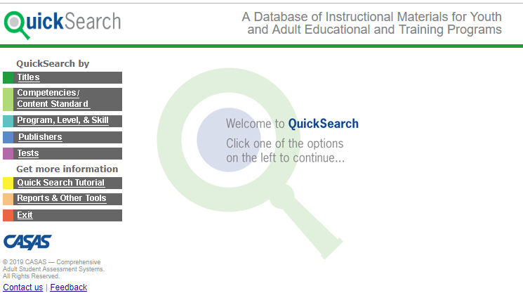
QuickSearch
Quick, easy access to database of more than 2,000 instructional materials
Includes print, audio, video, and software materials
Correlated to CASAS Competencies and Content Standards
Search by
Title
Competency
Program, Level, and Skill
Publisher
CASAS Assessment
Notes:
Developing targeted lesson plans like in the previous activity can be extremely beneficial, but we know that teachers don’t always have the time to track down supporting material. Quick Search helps to give you that head start.
Instructional Materials Quick Search help program coordinators and instructors select materials to match their curriculum.
Programs can use the CASAS Life and Work Test Series Competency Content
Review points and benefits of Instructional Materials Quick Search Updated annually to include new materials from publishers and software companies.

Slide 62
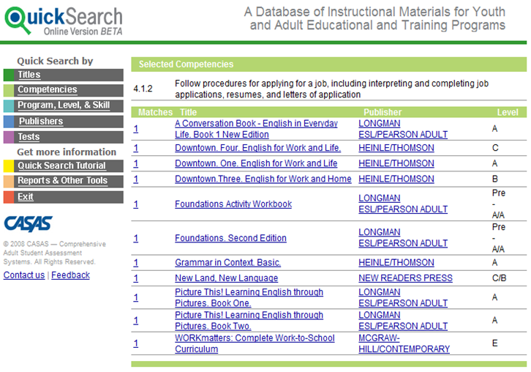
QuickSearch by Competencies
Notes:
Competency selected for this report: 4.1.2
This QS screen lists the results of a search by competency
Mention that multiple competency searches are possible. The books that address all or most of the competencies appear first; the books that address only one of the selected competencies appear last
TIME PERMITTING:
Pull up QuickSearch and show functionality. The trainer should already have logged in prior to the start of the session.

Slide 63
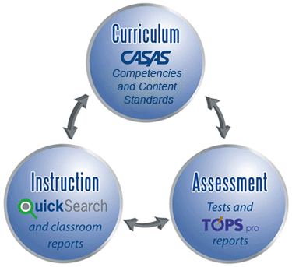
CASAS – a comprehensive system

Slide 64
Congratulations!
You have completed Module 4 – Interpreting Results and Reports!
To become a certified Tester:
Complete Modules 1 and 2 for eTesting
Complete Modules 1 and 3 for paper testing
Complete Modules 1, 2, and 3 for eTesting and paper testing

